Slide 1
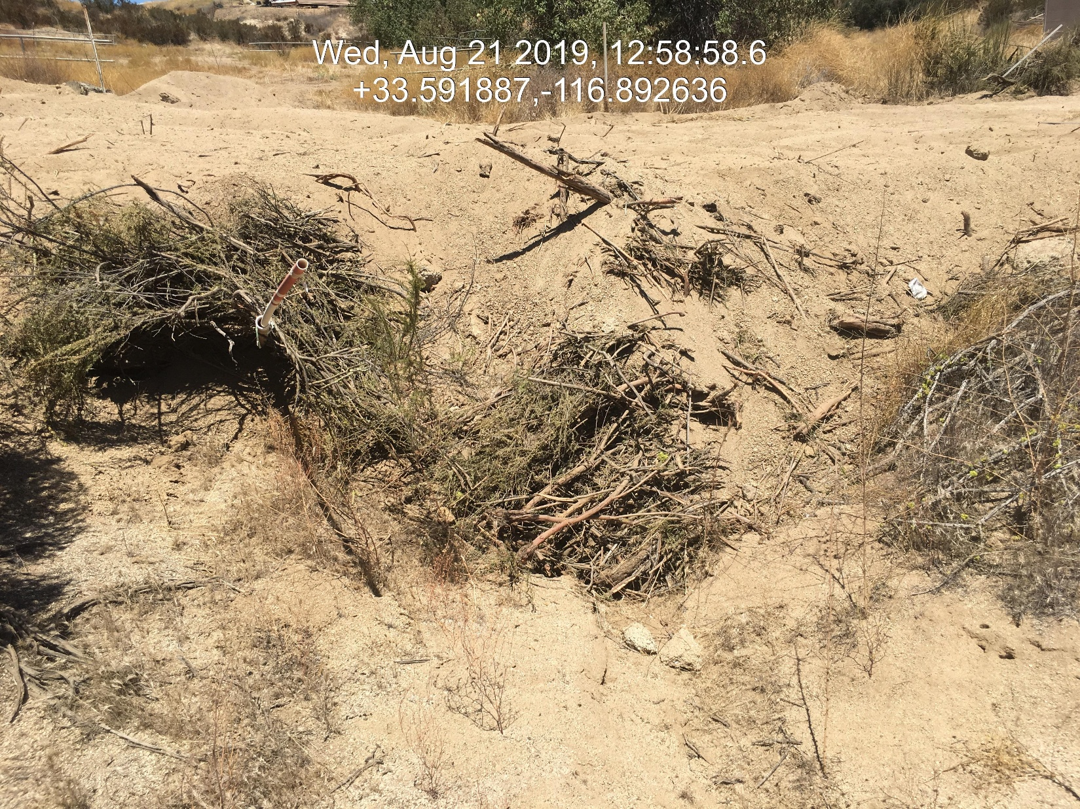
Case No: CV1903110
Situs Address:44100 GINGER CIR, HEMET CA
APN: 571-040-002

Slide 2
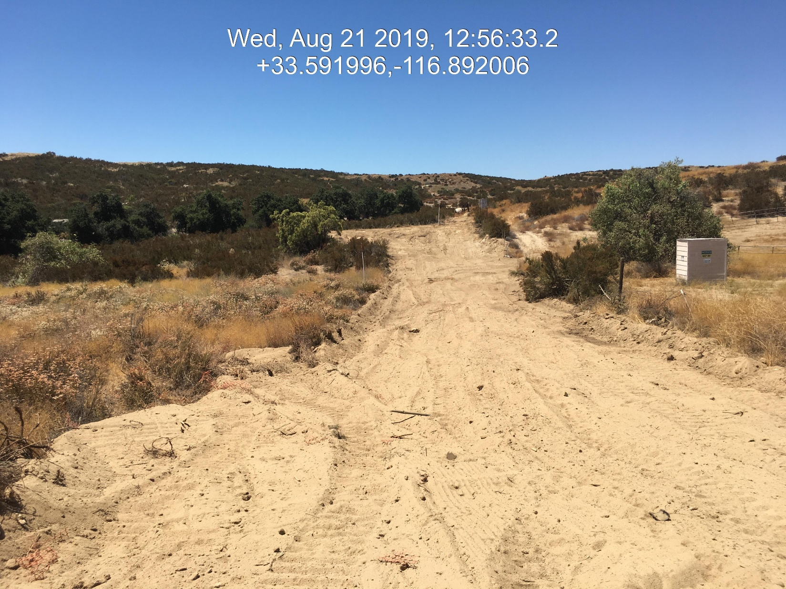
Case No: CV1903110
Situs Address:44100 GINGER CIR, HEMET CA
APN: 571-040-002

Slide 3
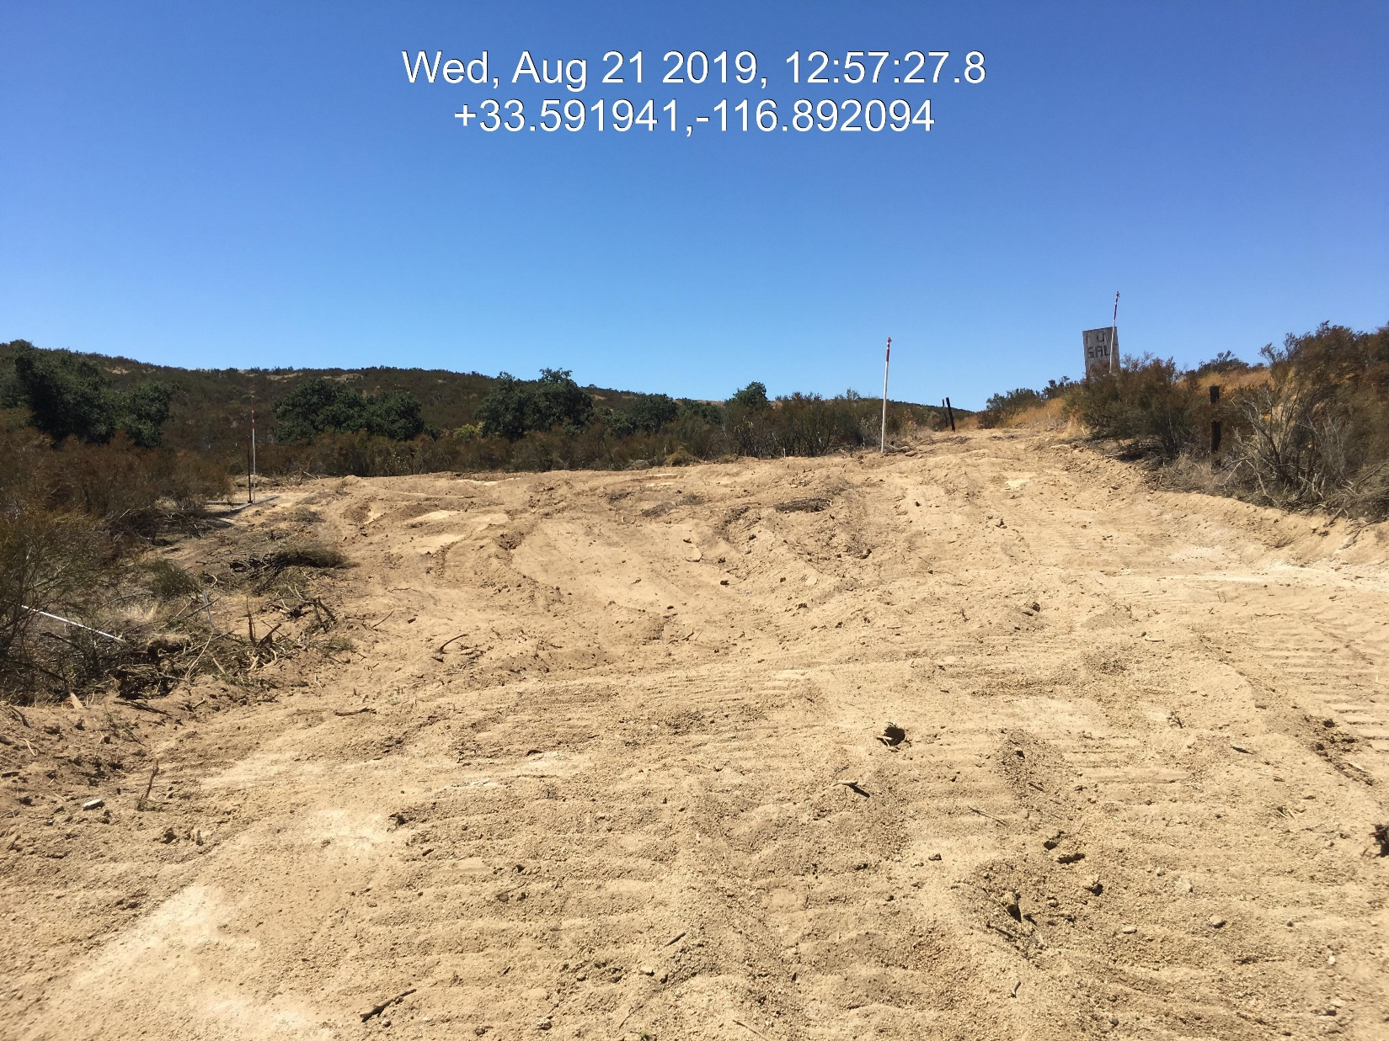
Case No: CV1903110
Situs Address:44100 GINGER CIR, HEMET CA
APN: 571-040-002

Slide 4
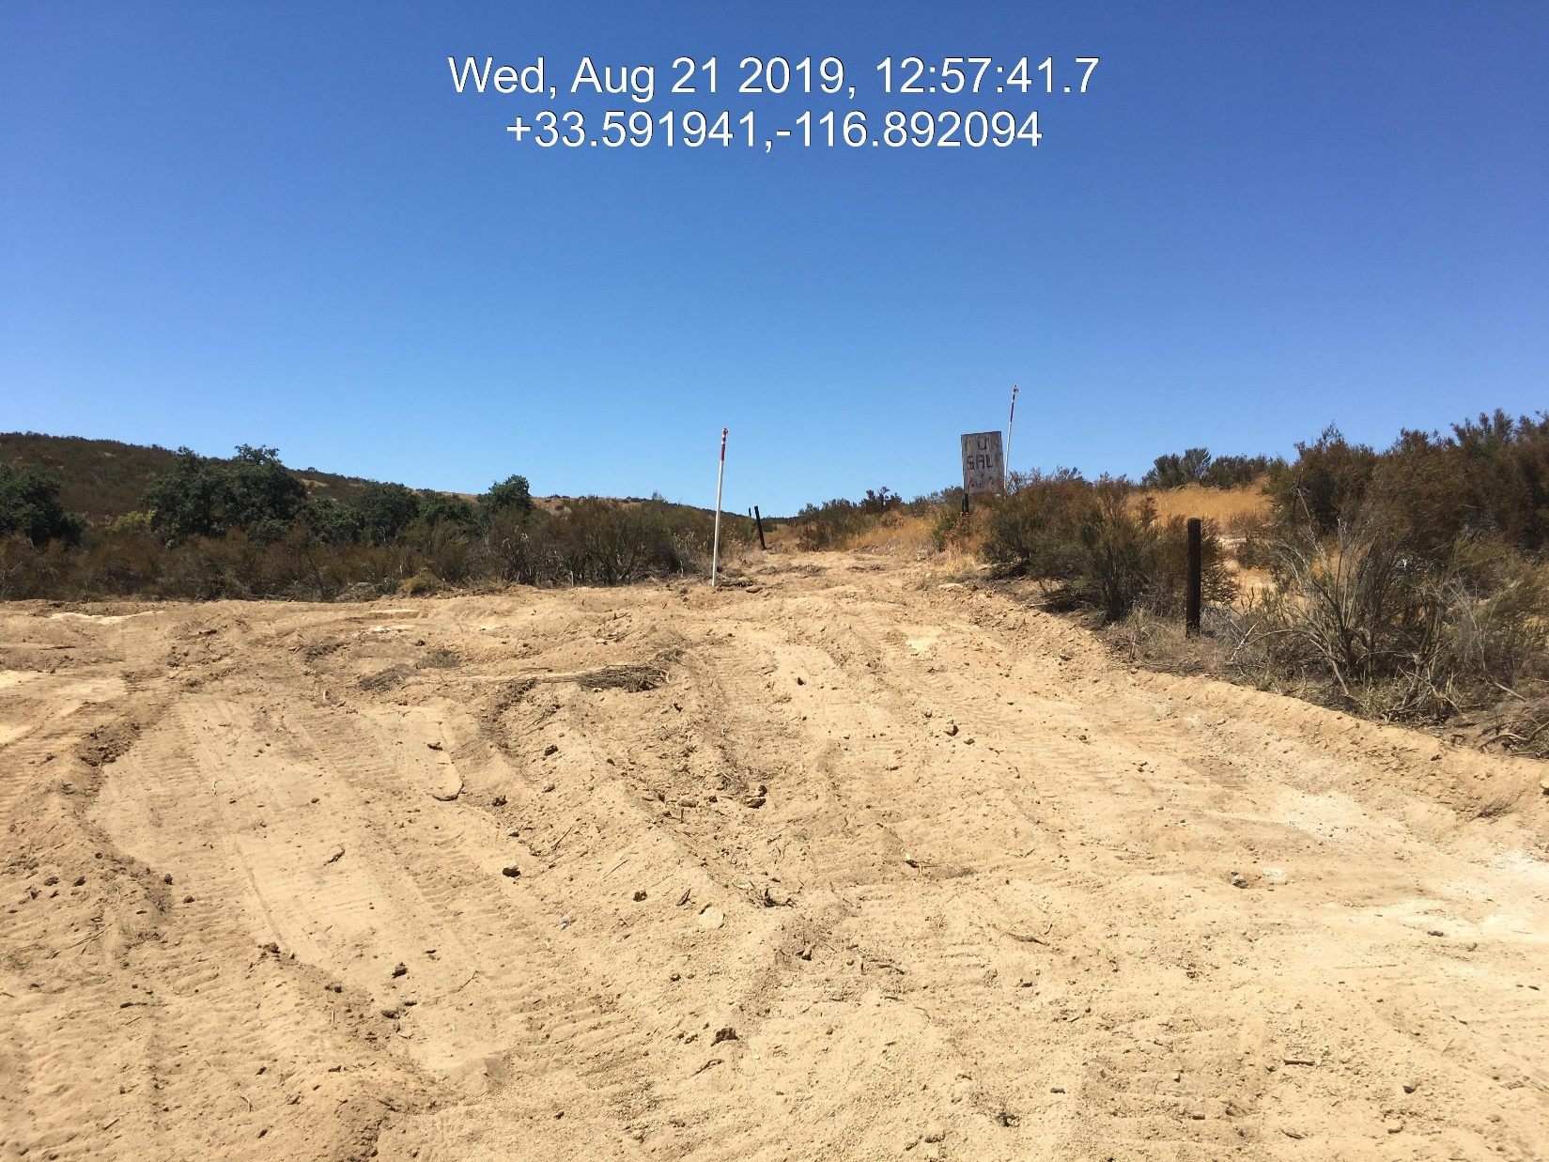
Case No: CV1903110
Situs Address:44100 GINGER CIR, HEMET CA
APN: 571-040-002

Slide 5
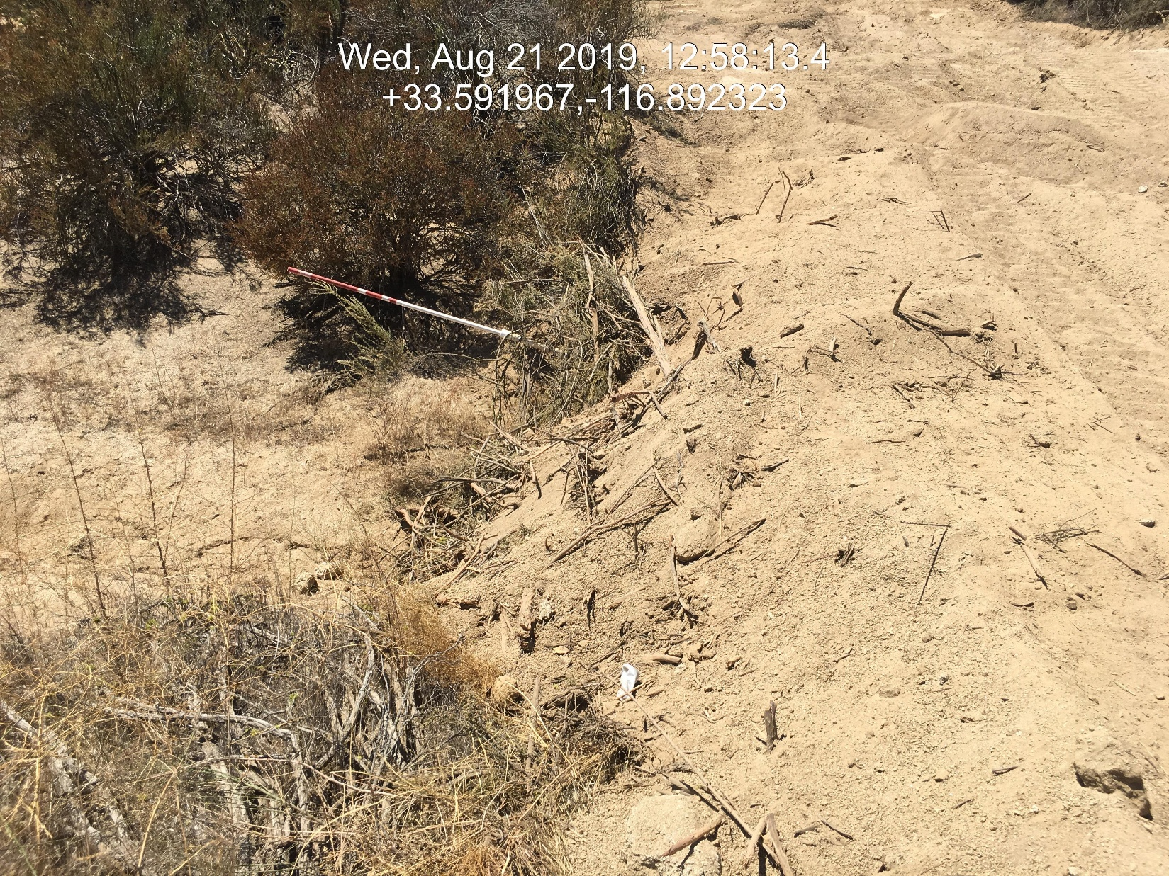
Case No: CV1903110
Situs Address:44100 GINGER CIR, HEMET CA
APN: 571-040-002

Slide 6
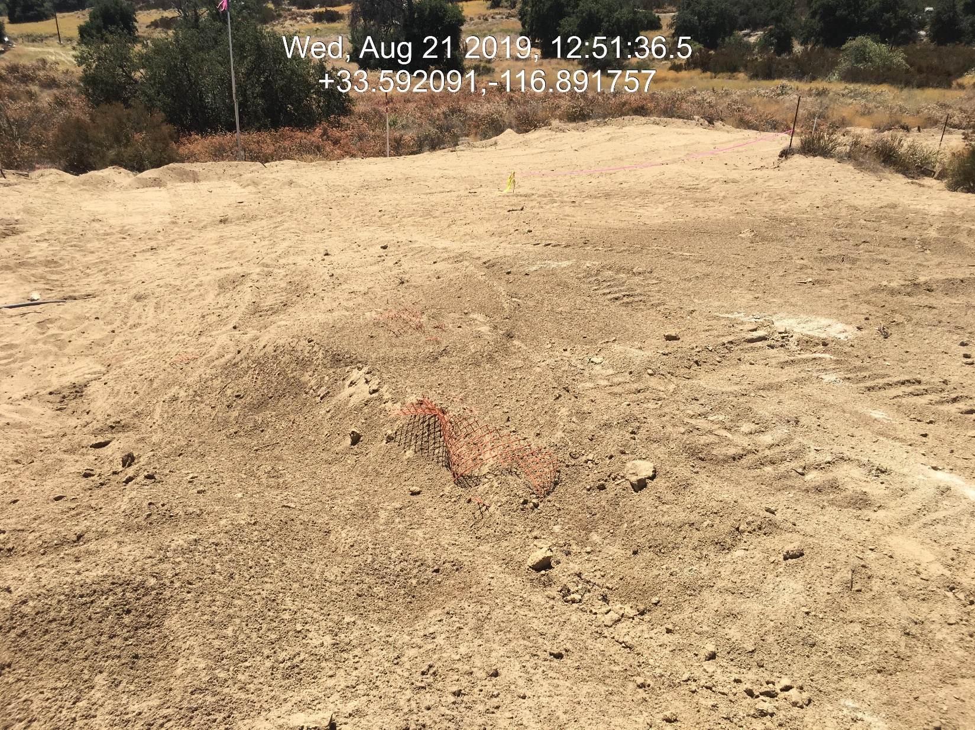
Case No: CV1903110
Situs Address:44100 GINGER CIR, HEMET CA
APN: 571-040-002

Slide 7
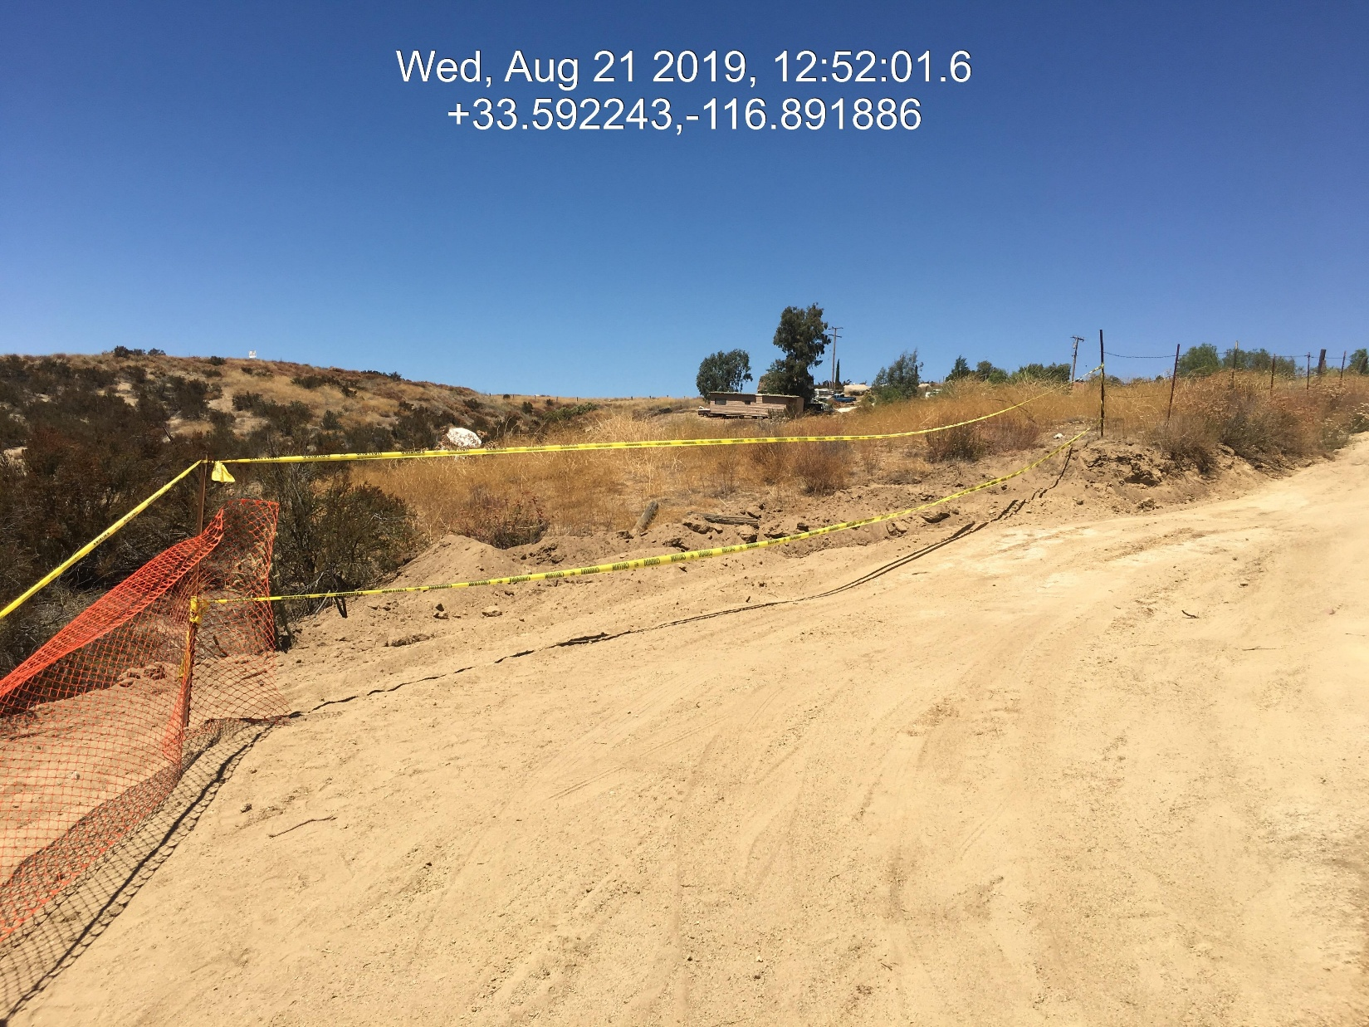
Case No: CV1903110
Situs Address:44100 GINGER CIR, HEMET CA
APN: 571-040-002

Slide 8
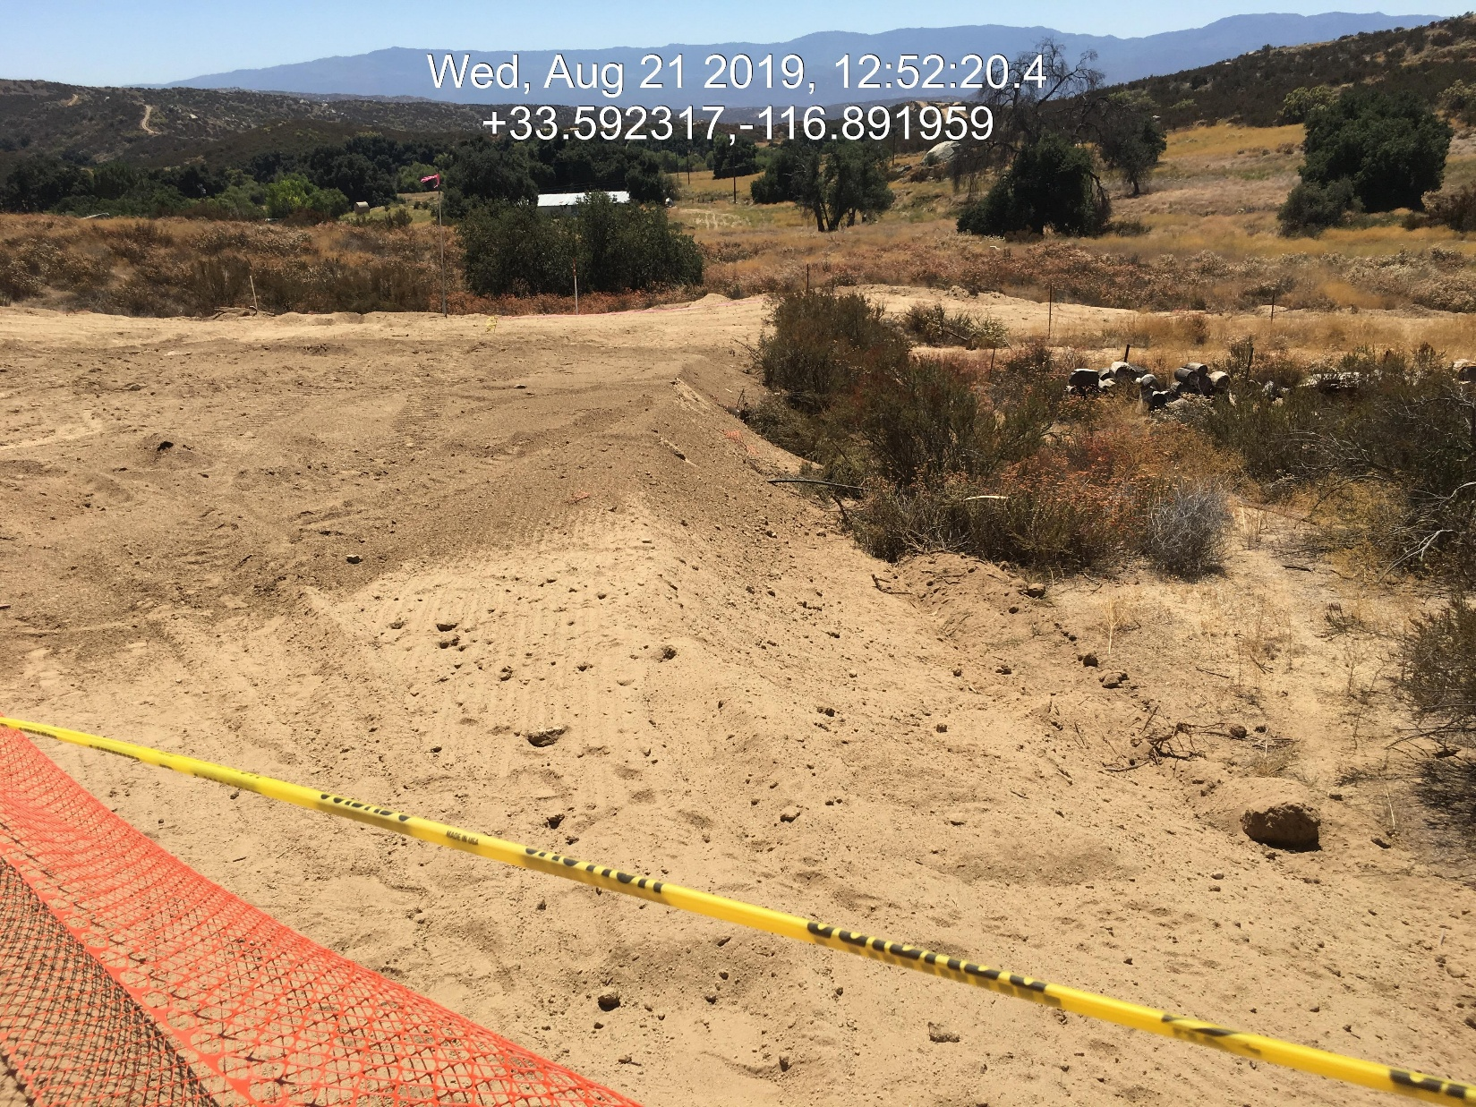
Case No: CV1903110
Situs Address:44100 GINGER CIR, HEMET CA
APN: 571-040-002

Slide 9
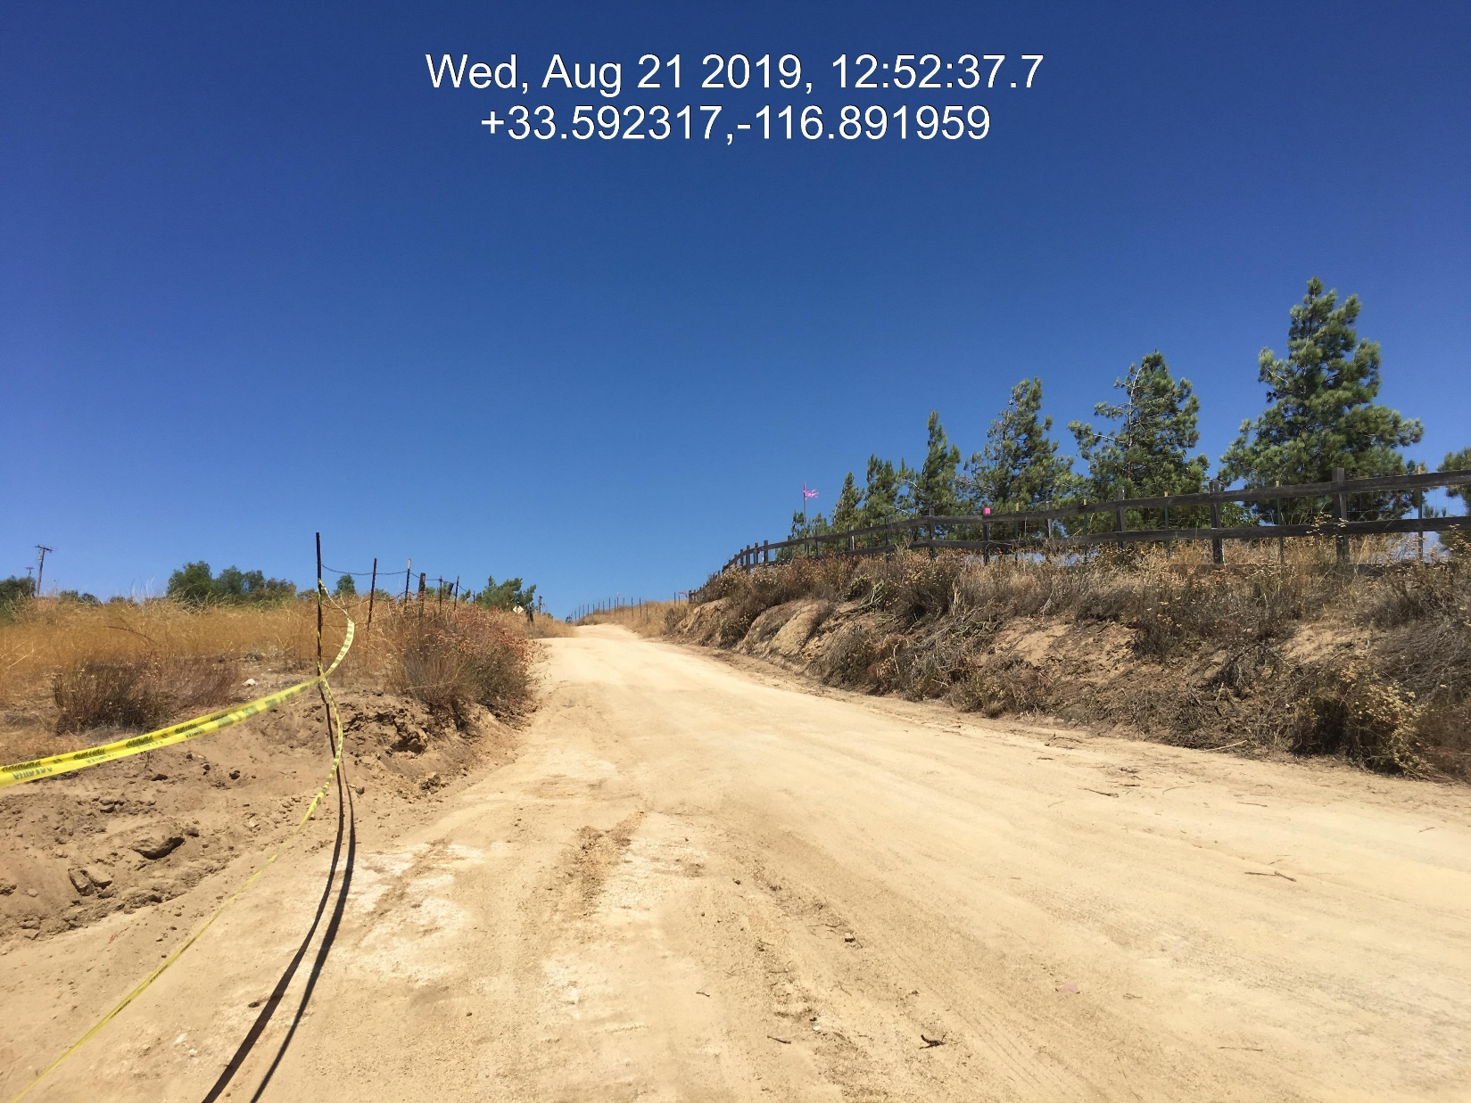
Case No: CV1903110
Situs Address:44100 GINGER CIR, HEMET CA
APN: 571-040-002

Slide 10
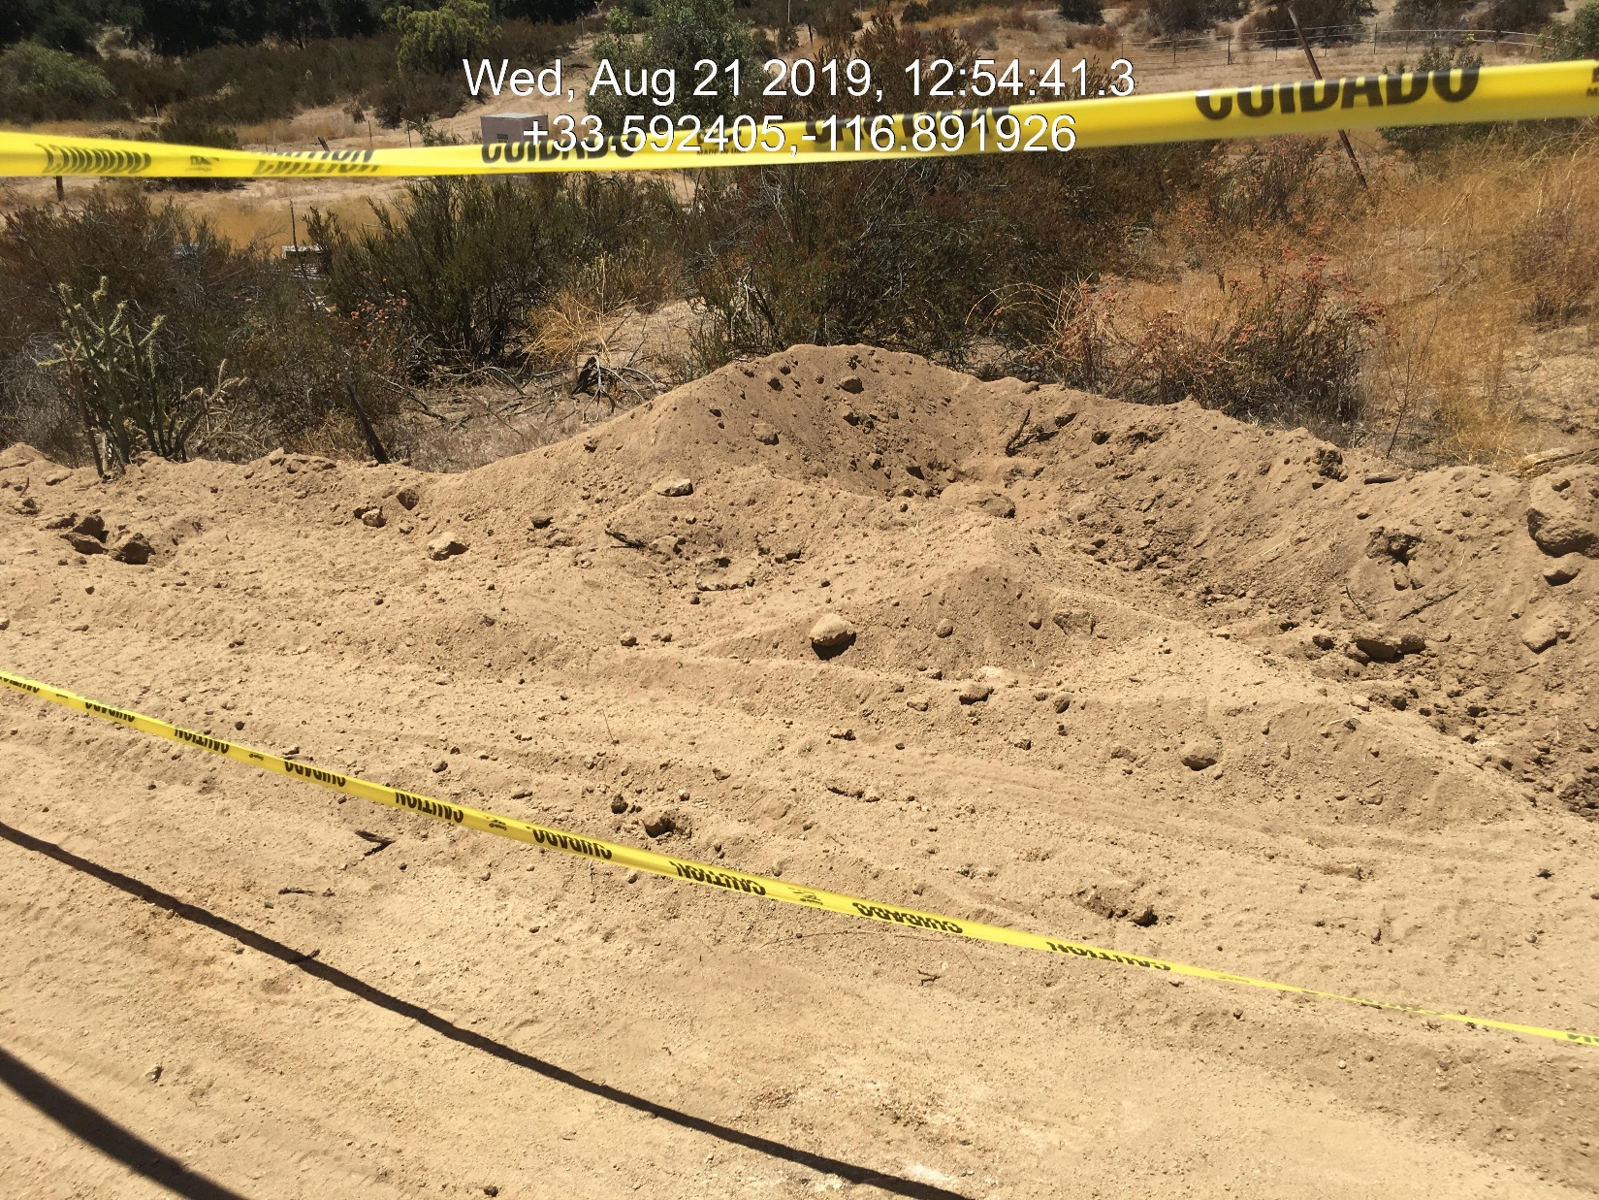
Case No: CV1903110
Situs Address:44100 GINGER CIR, HEMET CA
APN: 571-040-002

Slide 11
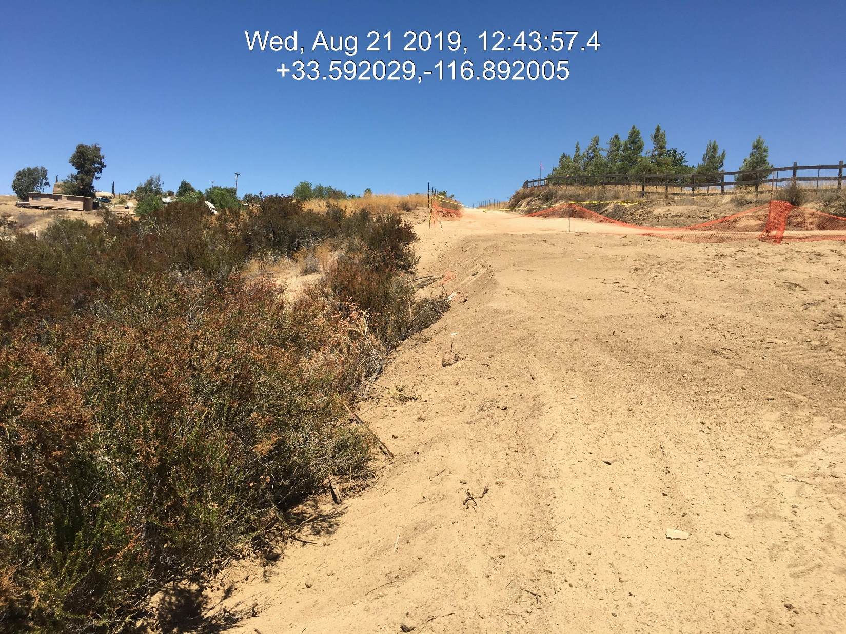
Case No: CV1903110
Situs Address:44100 GINGER CIR, HEMET CA
APN: 571-040-002

Slide 12
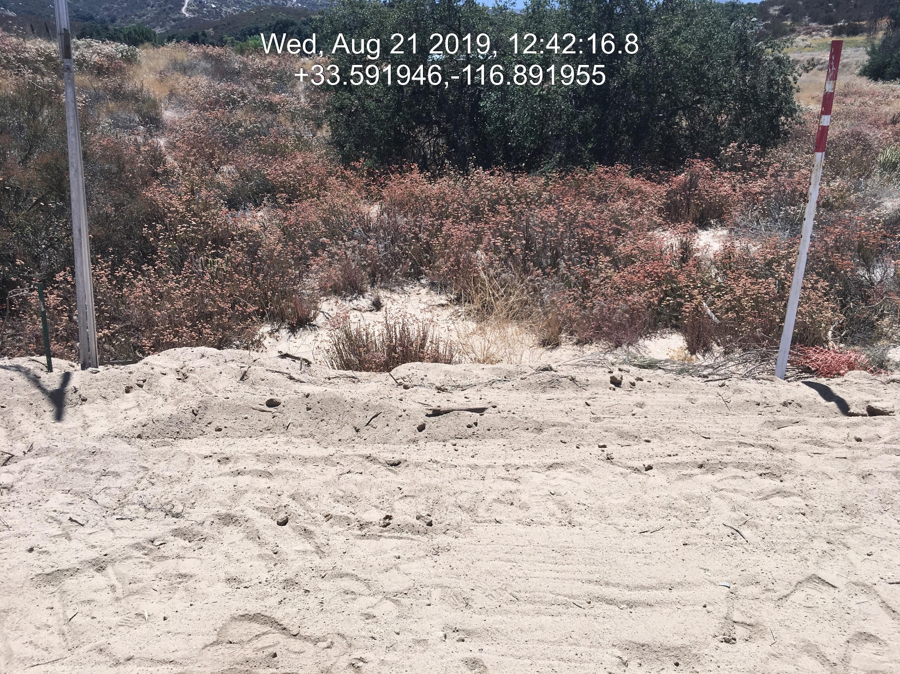
Case No: CV1903110
Situs Address:44100 GINGER CIR, HEMET CA
APN: 571-040-002

Slide 13
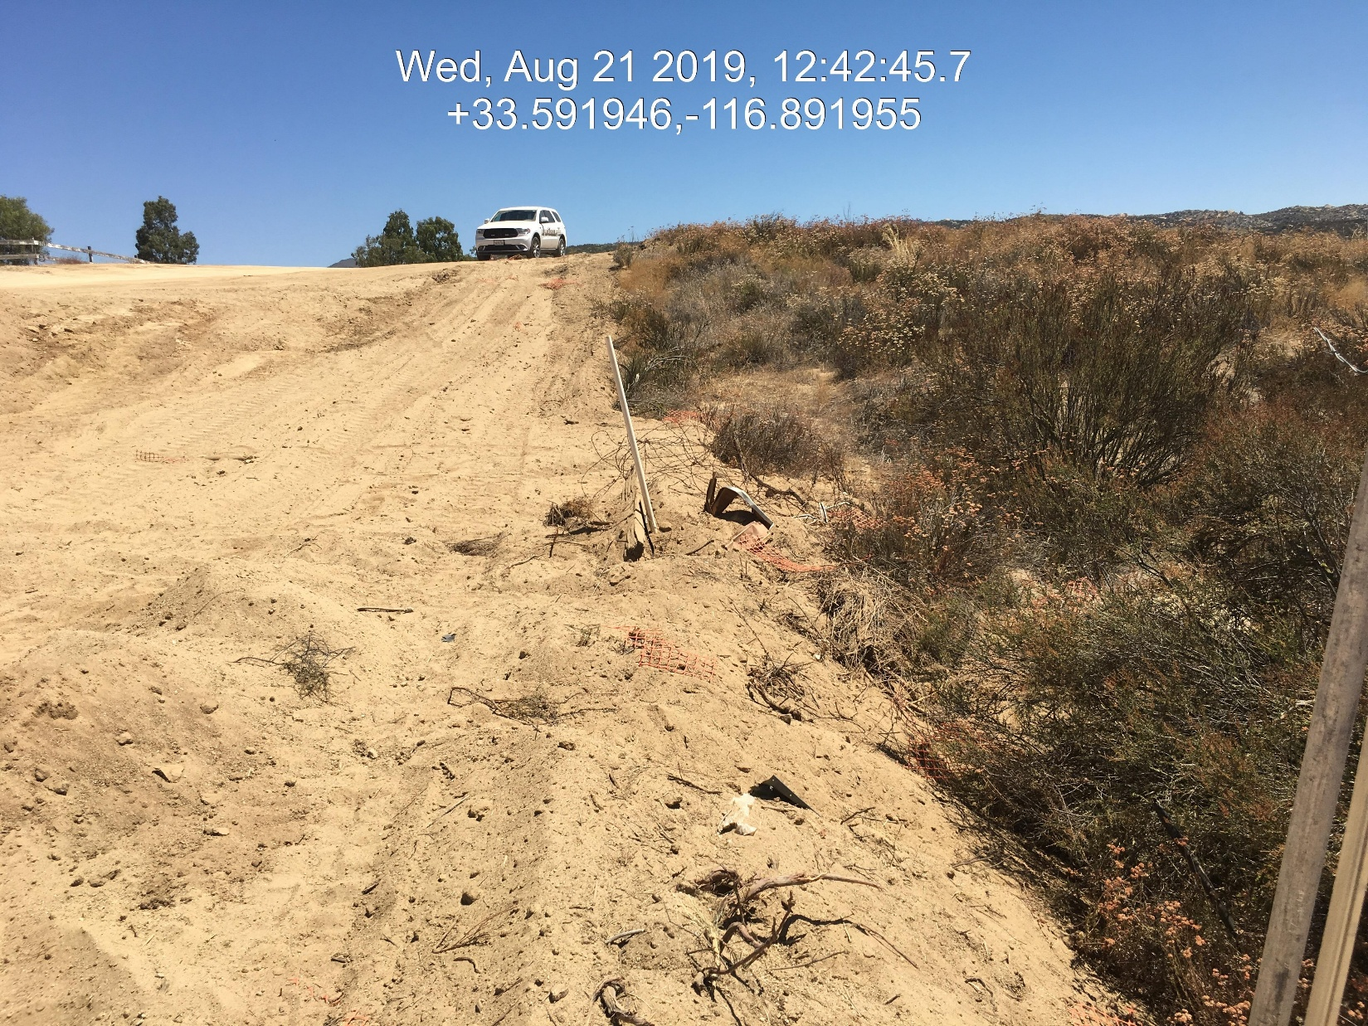
Case No: CV1903110
Situs Address:44100 GINGER CIR, HEMET CA
APN: 571-040-002

Slide 14
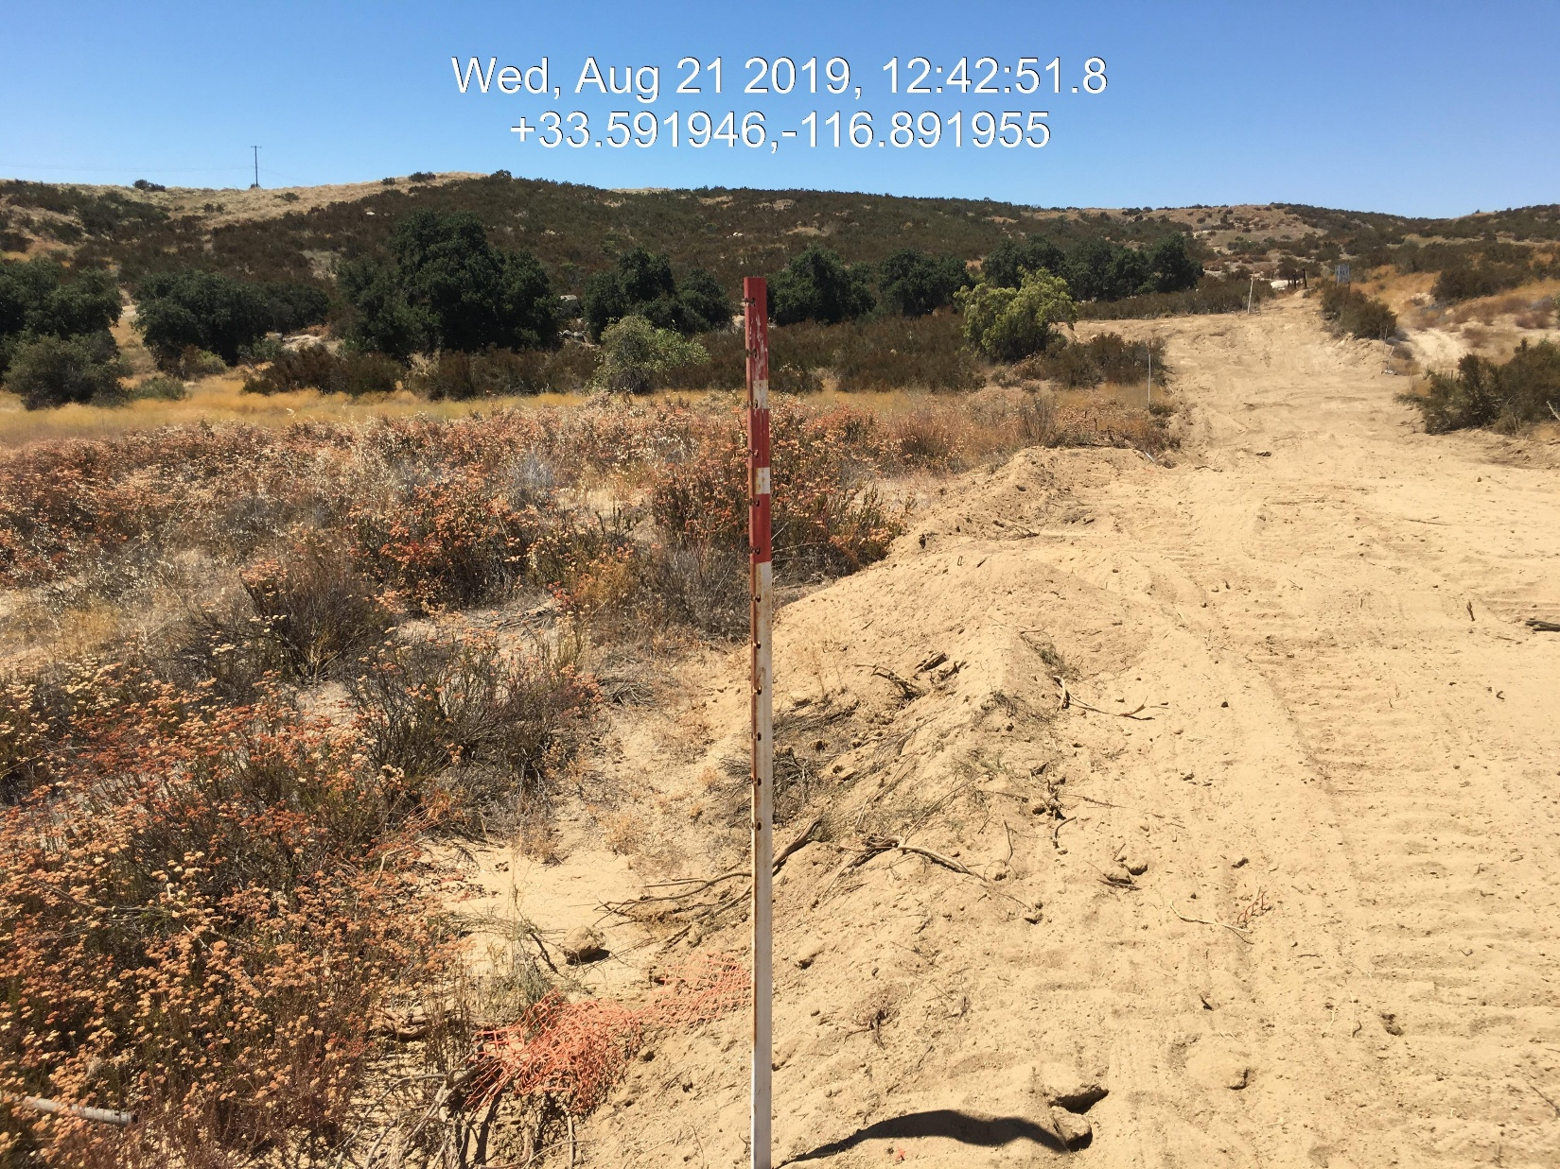
Case No: CV1903110
Situs Address:44100 GINGER CIR, HEMET CA
APN: 571-040-002

Slide 15
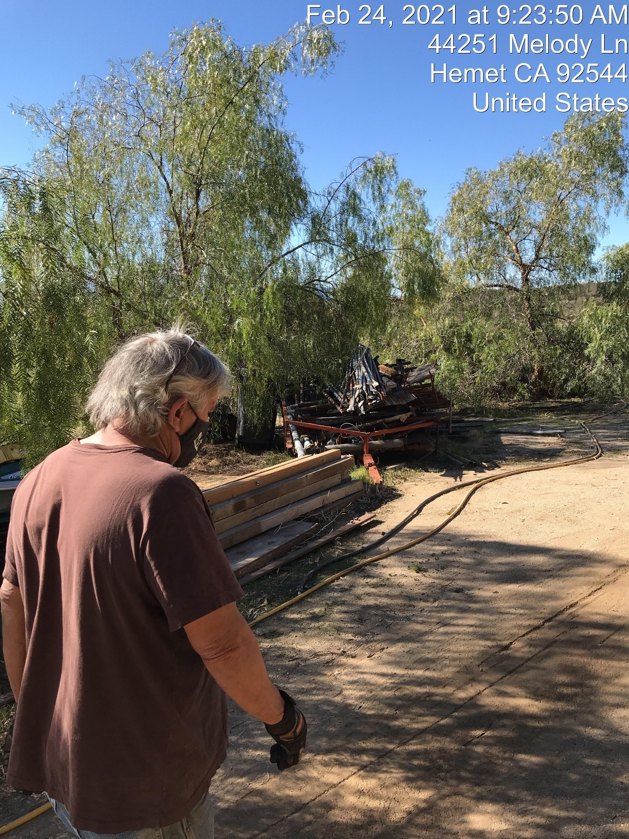
Case No: CV1903110
Situs Address:44100 GINGER CIR, HEMET CA
APN: 571-040-002

Slide 16
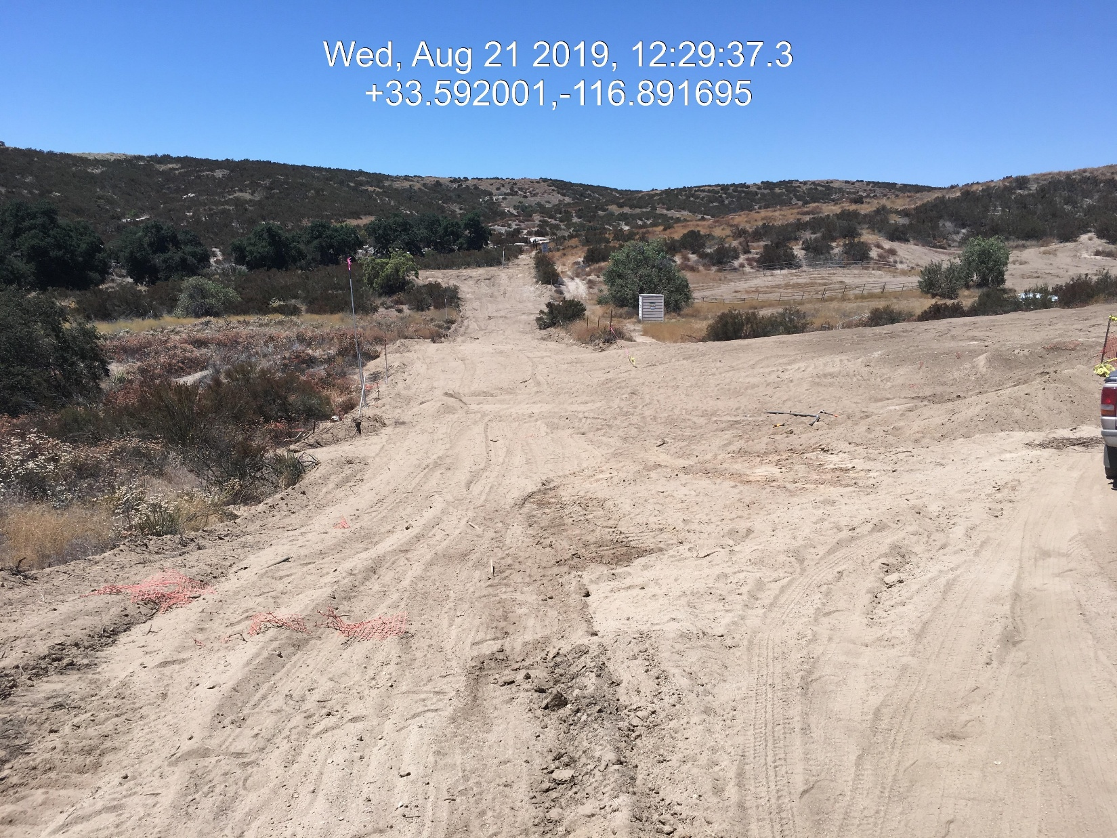
Case No: CV1903110
Situs Address:44100 GINGER CIR, HEMET CA
APN: 571-040-002

Slide 17
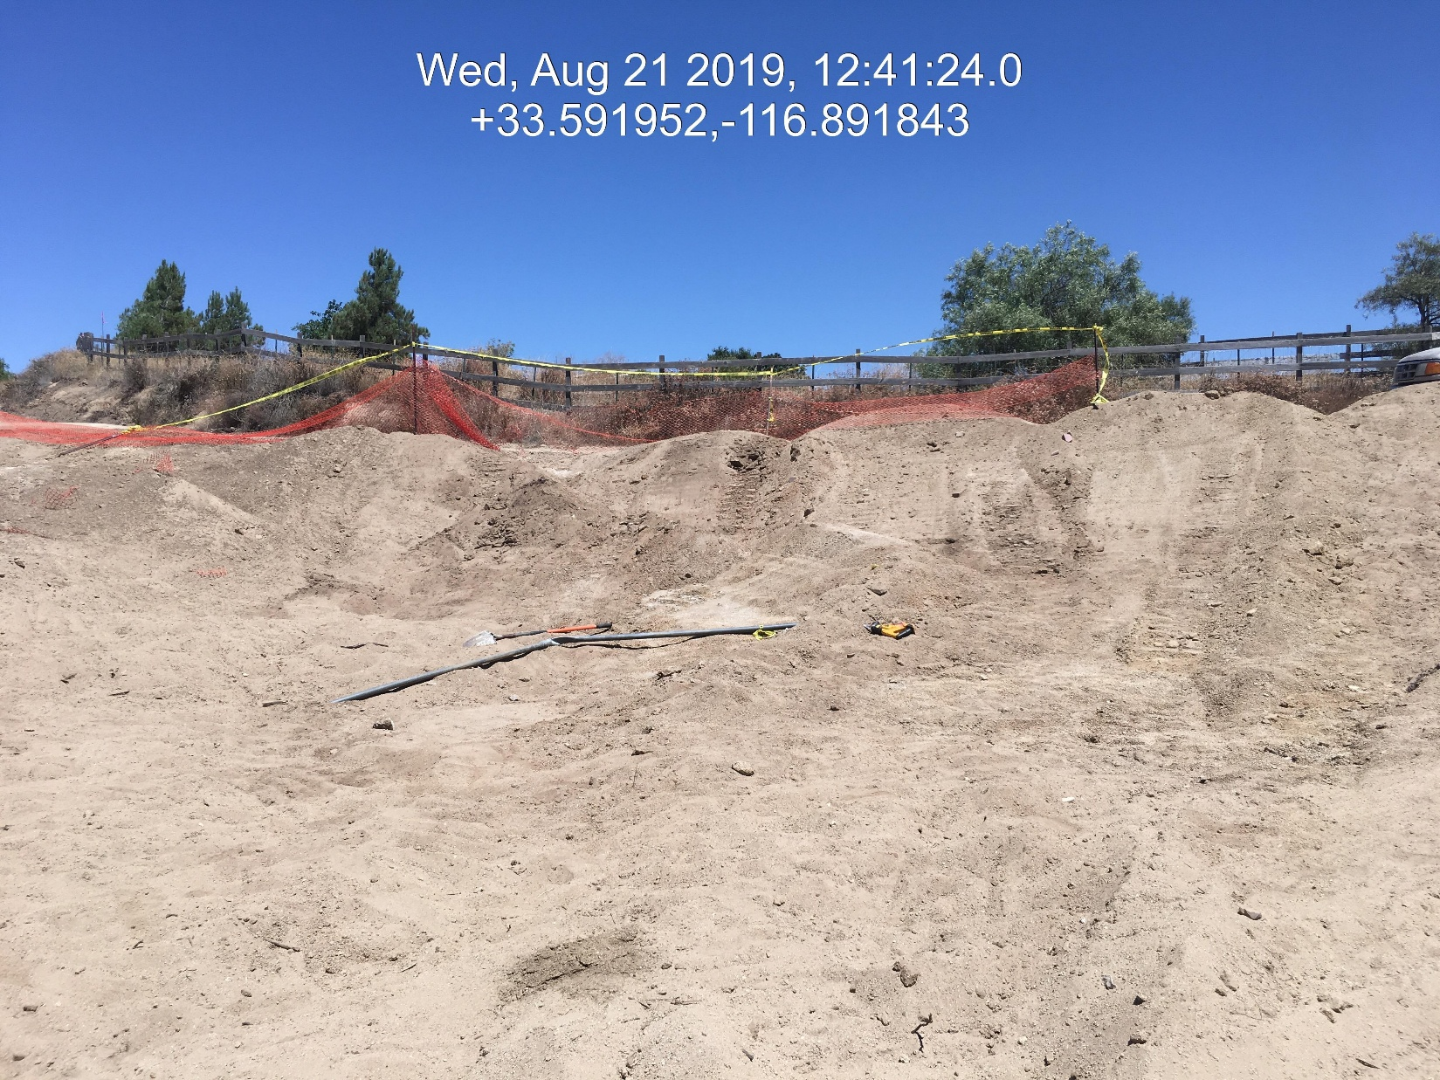
Case No: CV1903110
Situs Address:44100 GINGER CIR, HEMET CA
APN: 571-040-002

Slide 18
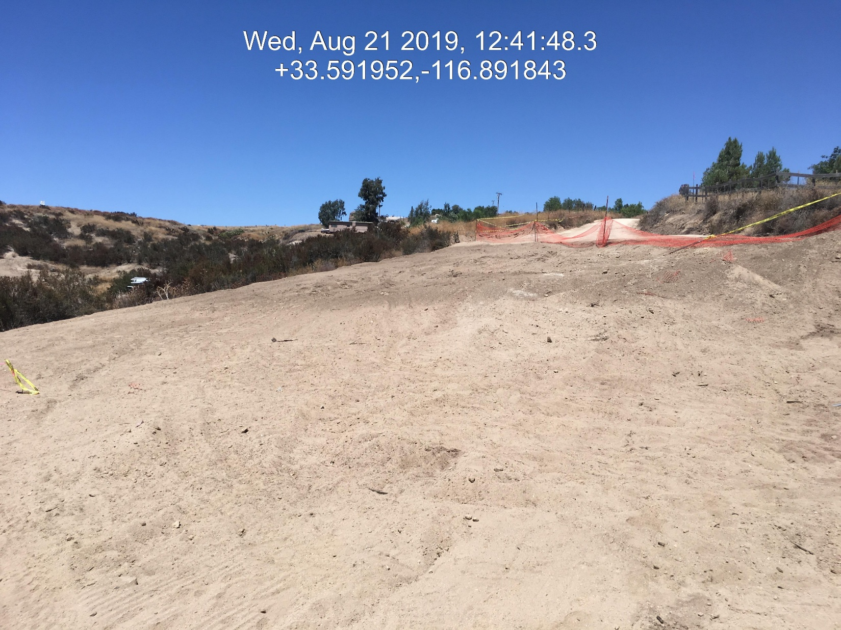
Case No: CV1903110
Situs Address:44100 GINGER CIR, HEMET CA
APN: 571-040-002

Slide 19
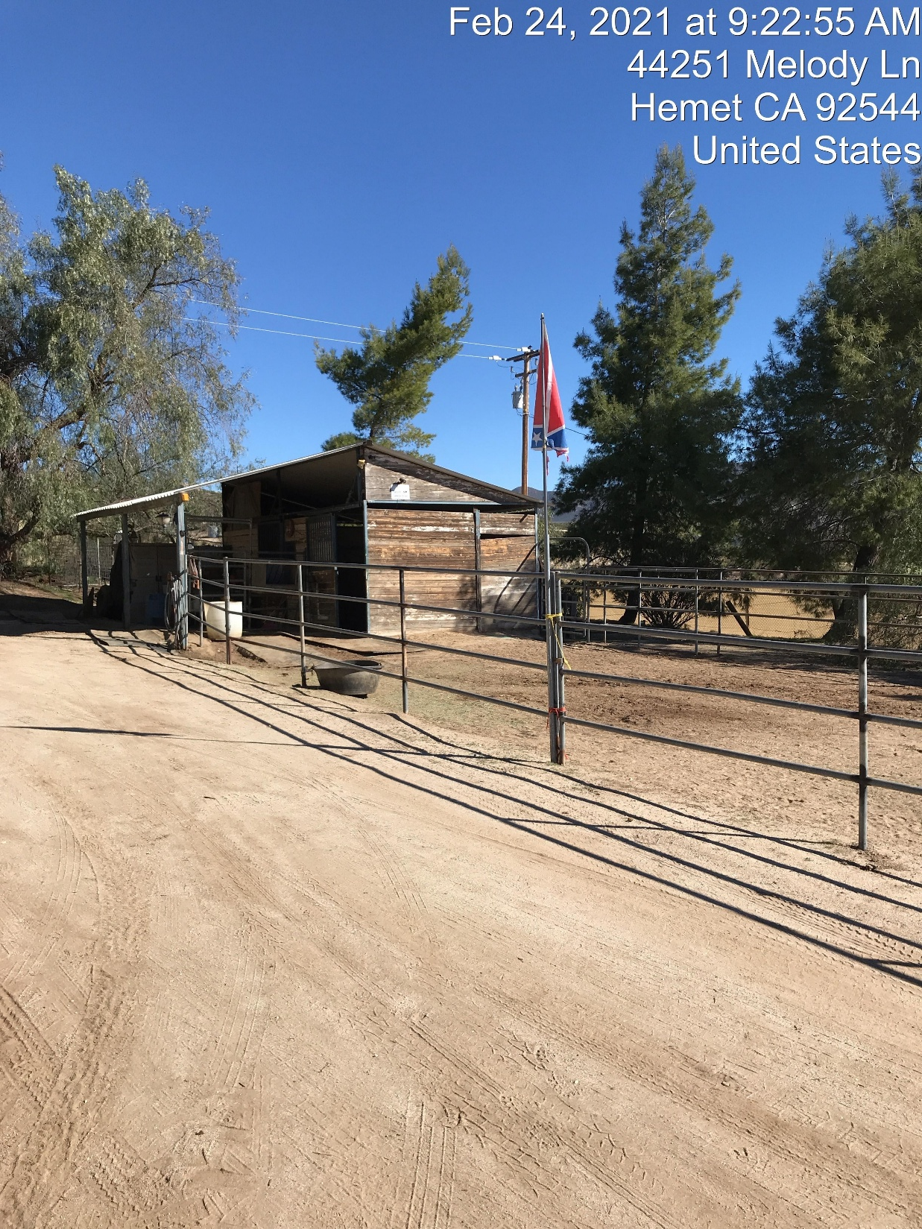
Case No: CV1903110
Situs Address:44100 GINGER CIR, HEMET CA
APN: 571-040-002

Slide 20
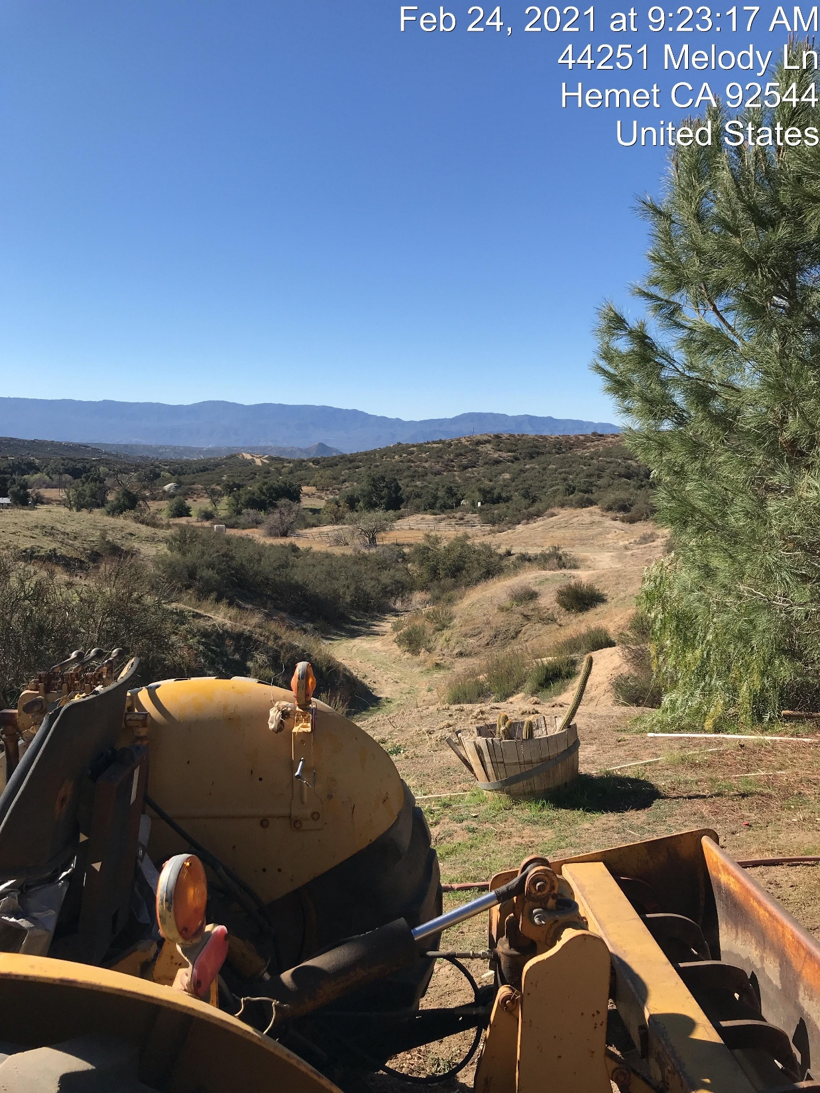
Case No: CV1903110
Situs Address:44100 GINGER CIR, HEMET CA
APN: 571-040-002

Slide 21
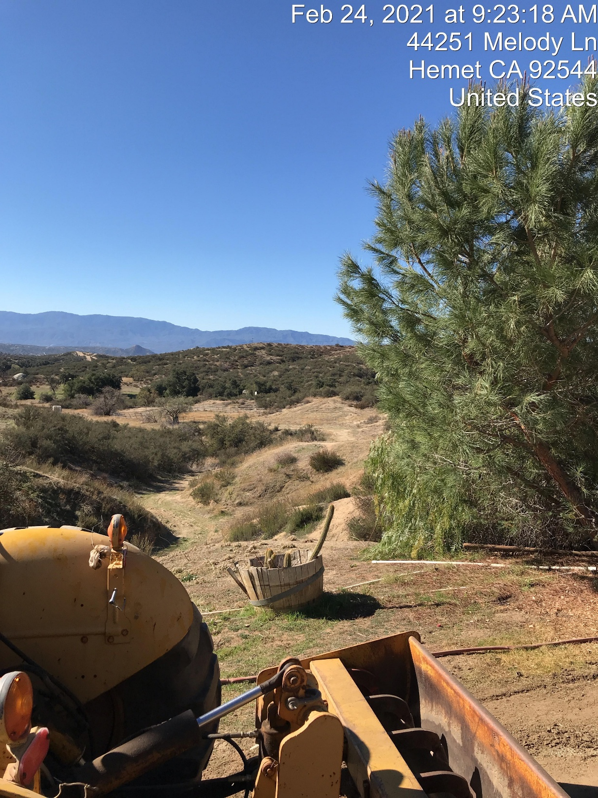
Case No: CV1903110
Situs Address:44100 GINGER CIR, HEMET CA
APN: 571-040-002

